Slide 1
HQ- SASARAM ( S2H AREA SASARAM)

Slide 2
SP-TS Report Under S2H Projects for the month of August - 2025
10 Farmers meeting and a Crop Seminar organised in S2H Villages of Rohtas district.

Slide 3
Campaign -Objective
We have organised 10 farmers meetings and a crop seminar conducted during the month of August 2025 for promotion and awareness of Uttam Products as well as CPC&SN.
Objective of Campaign:-
Effective Massage convey of S2H project.
To Plan CFCL Brand promotion activity among the Farmers.
To Provide Awareness about use of different micronutrient as per the soil demand and crop requirement .
Balance Fertiliser uses.

Slide 4
Main Points discussed during campaign
First, We are taken soil sample & deliver results to farmers this campaign will create a good relationship with farmers which help to penetrate SN & CPC Sales in that villages .
In these campaign we thrust for speciality nutrient and crop protection chemicals.
After understating of their consumption pattern, we delivered our knowledge thoroughly regarding consumption of fertilisers.

Slide 5
Observations of Farmers meeting
Farmers are Not aware about Soil testing & Nutrition .
Now we are targeting to increase no of soil sample & build relation with farmers.
Quality wise they accept uttam product as very good category.
Its common observation Farmer were very interested to know the soil sample results
.

Slide 6
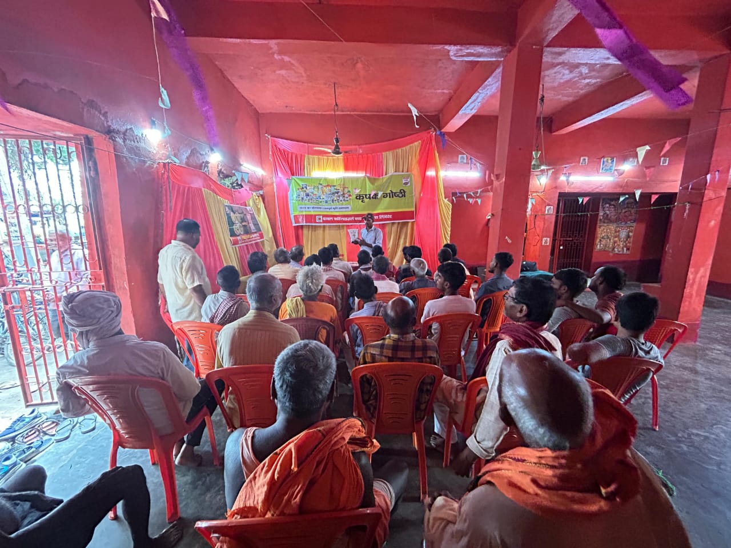
Glimpse of farmers meeting
VILLAGE | CHANKA
BLOCK | NOKHA
DISTRICT | ROHTAS
DATE | 03/08/2025

Slide 7
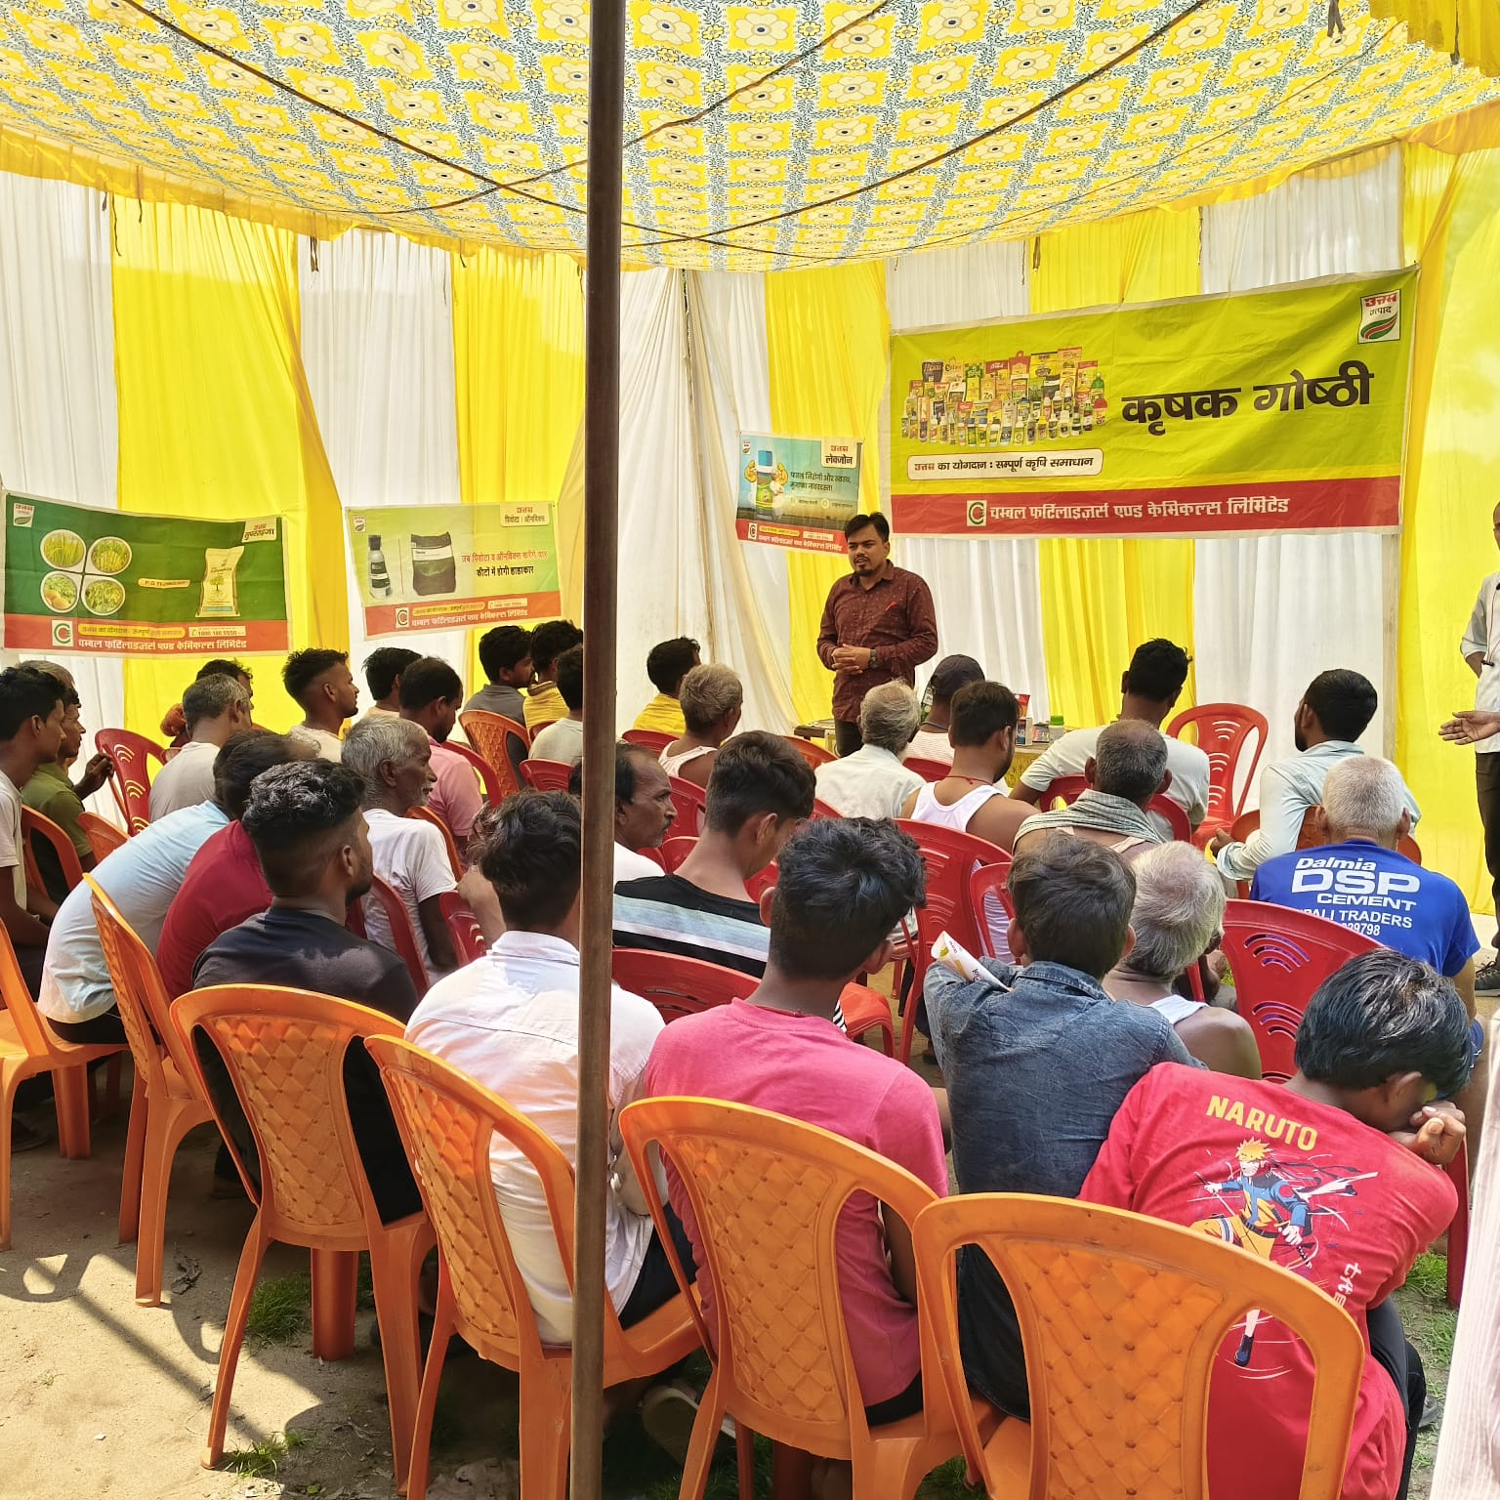
Glimpse of farmers meeting
VILLAGE | BARADIH
BLOCK | TILOUTHU
DISTRICT | ROHTAS
DATE | 05/08/2025

Slide 8
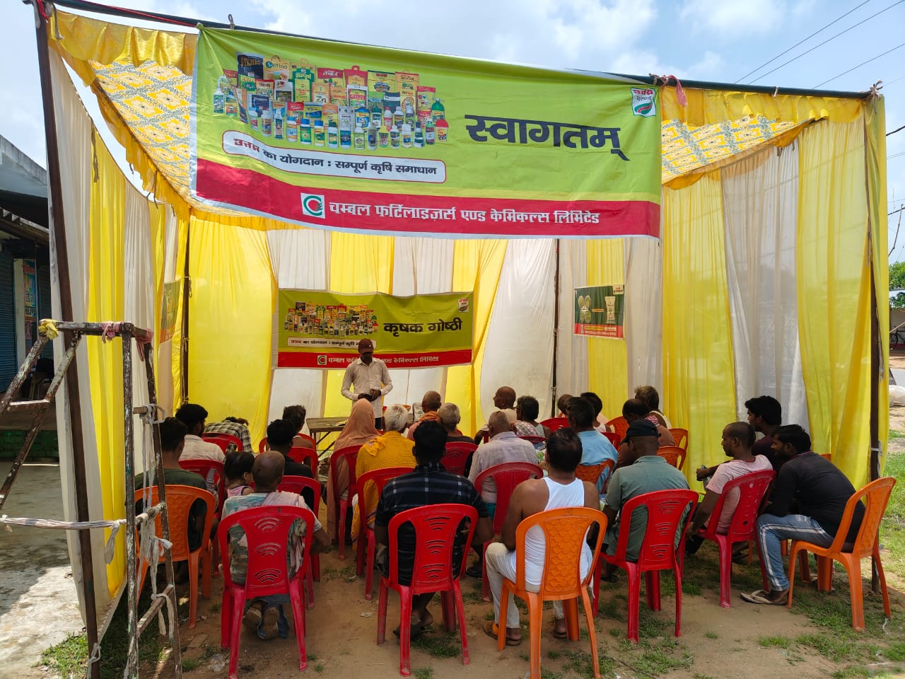
Glimpse of farmers meeting
VILLAGE | HARNACHITI
BLOCK | TILOUTHU
DISTRICT | ROHTAS
DATE | 08/08/2025

Slide 9
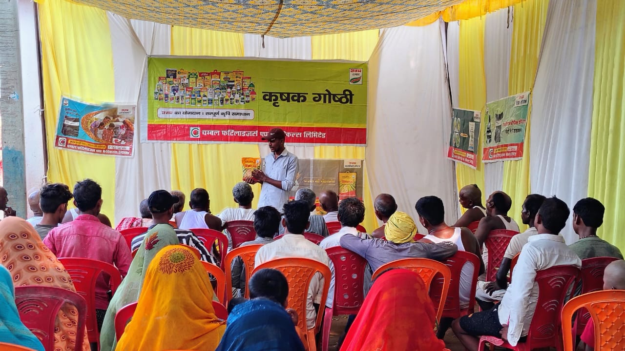
Glimpse of farmers meeting
VILLAGE | HURUKA
BLOCK | TILOUTHU
DISTRICT | ROHTAS
DATE | 09/08/2025

Slide 10
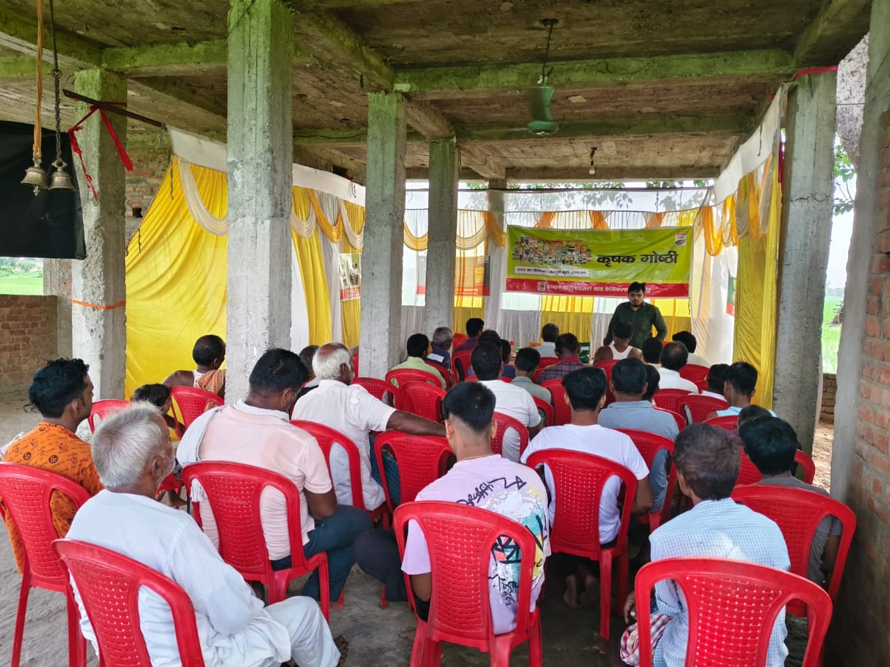
Glimpse of farmers meeting
VILLAGE | KUSHDIHRA
BLOCK | TILOUTHU
DISTRICT | ROHTAS
DATE | 13/08/2025

Slide 11
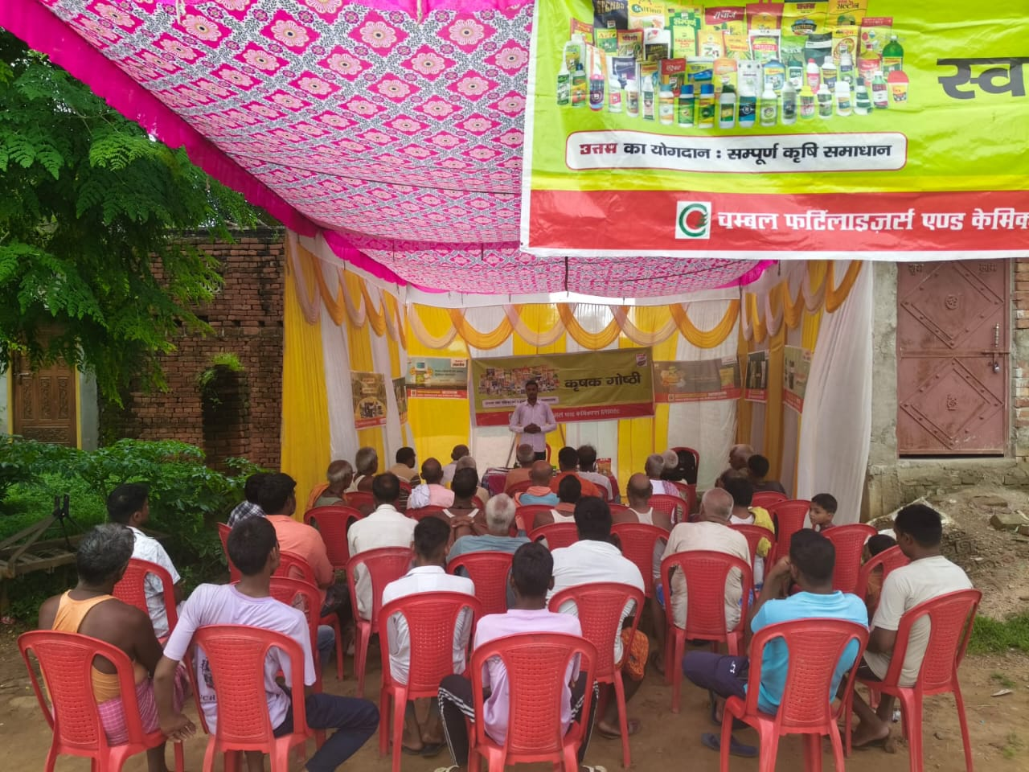
Glimpse of farmers meeting
VILLAGE | NAWADIH
BLOCK | TILOUTHU
DISTRICT | ROHTAS
DATE | 16/08/2025

Slide 12
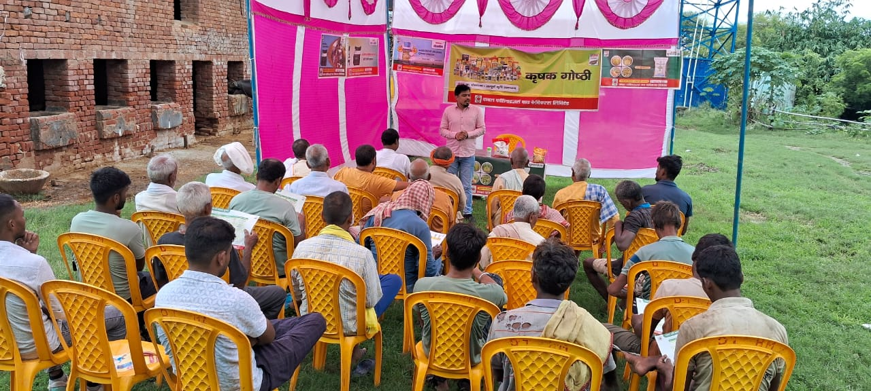
Glimpse of farmers meeting
VILLAGE | RENDIA
BLOCK | CHENARI
DISTRICT | ROHTAS
DATE | 19/08/2025

Slide 13
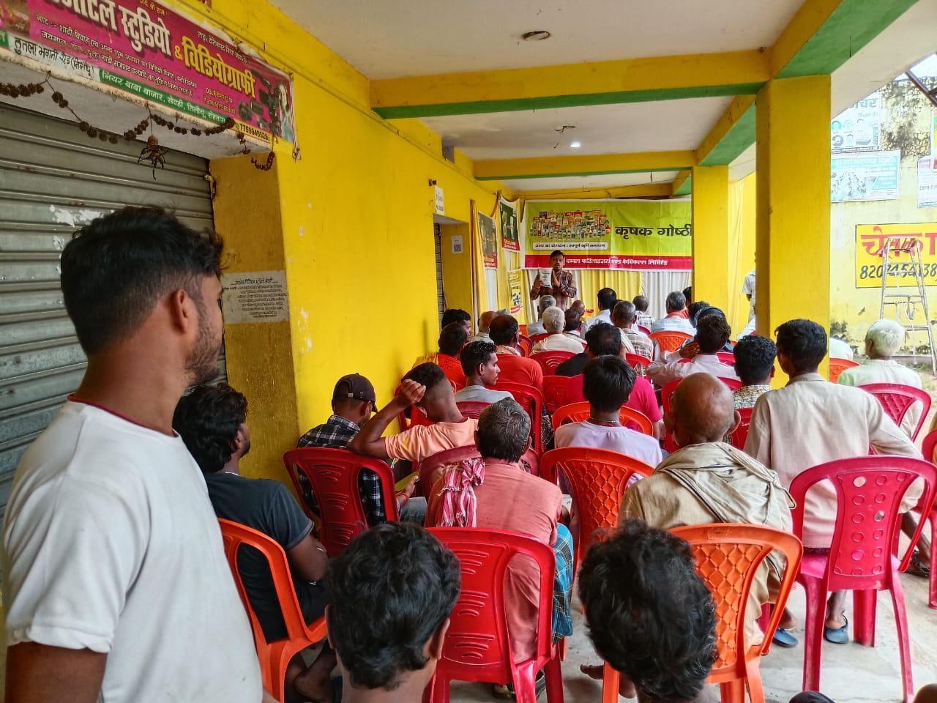
Glimpse of farmers meeting
VILLAGE | SEWAHI
BLOCK | TILOUTHU
DISTRICT | ROHTAS
DATE | 23/08/2025

Slide 14
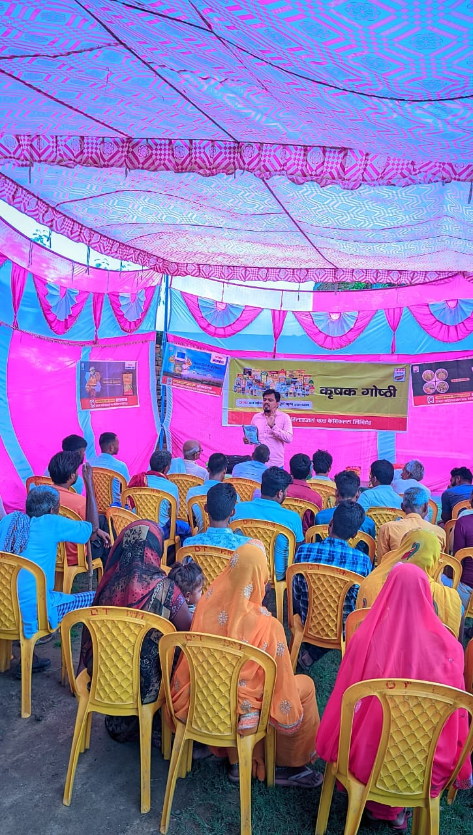
Glimpse of farmers meeting
VILLAGE | SHAHPUR
BLOCK | CHENARI
DISTRICT | ROHTAS
DATE | 25/08/2025

Slide 15
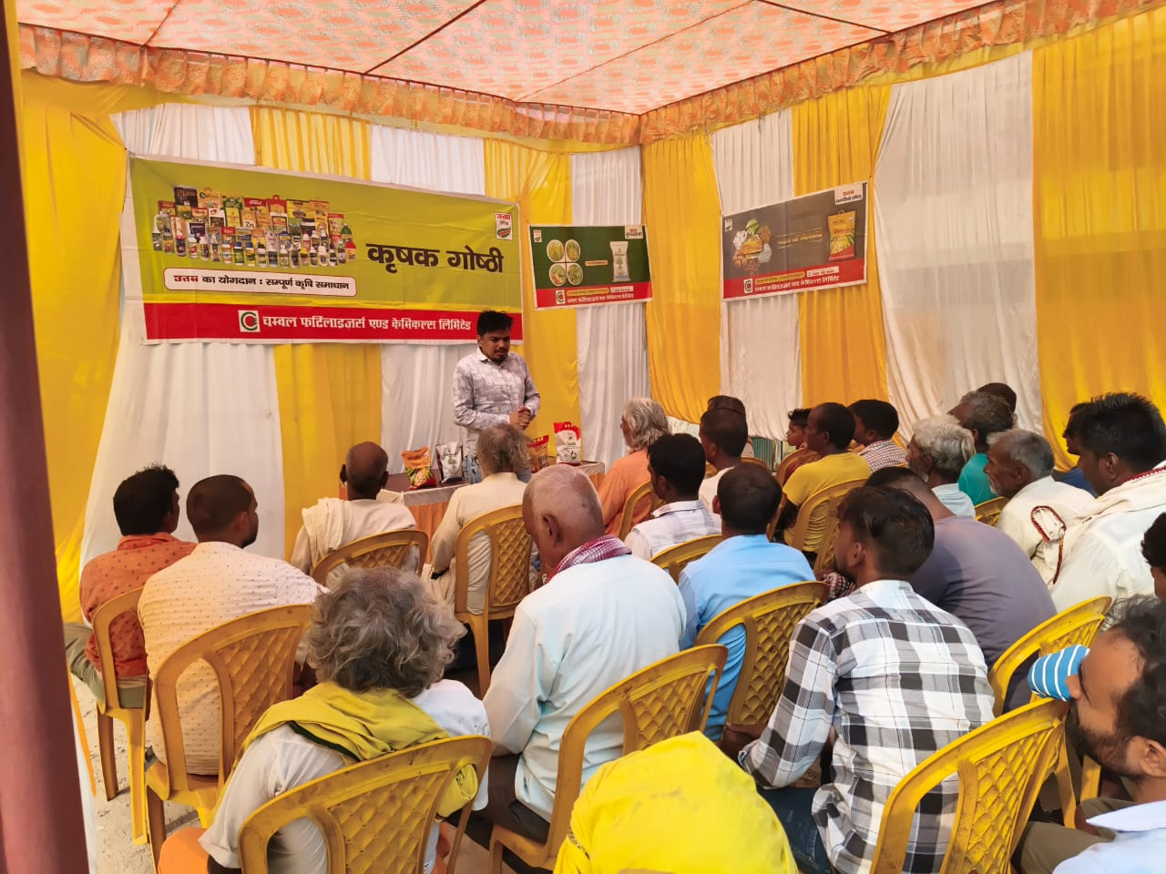
Glimpse of farmers meeting
VILLAGE | TENDUNI
BLOCK | CHENARI
DISTRICT | ROHTAS
DATE | 21/08/2025

Slide 16
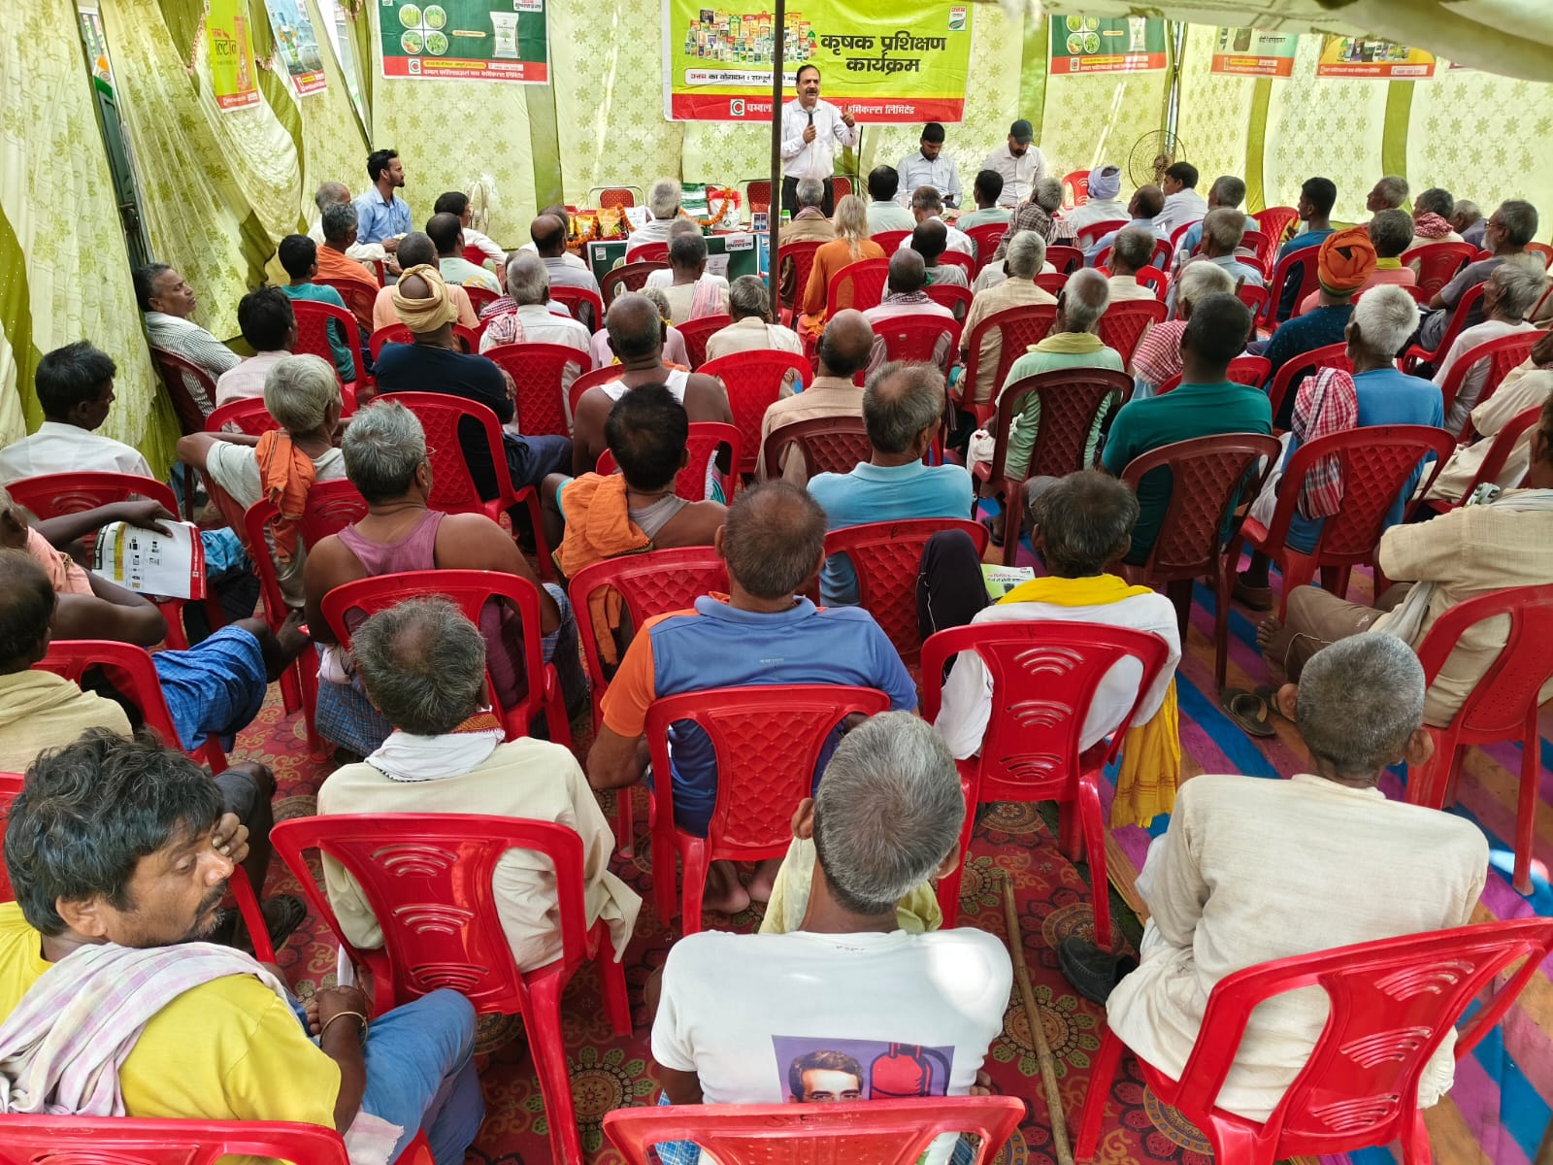
Glimpse of Crop Seminar
VILLAGE | CHANKA
BLOCK | NOKHA
DISTRICT | ROHTAS
DATE | 29/08/2025

Slide 17
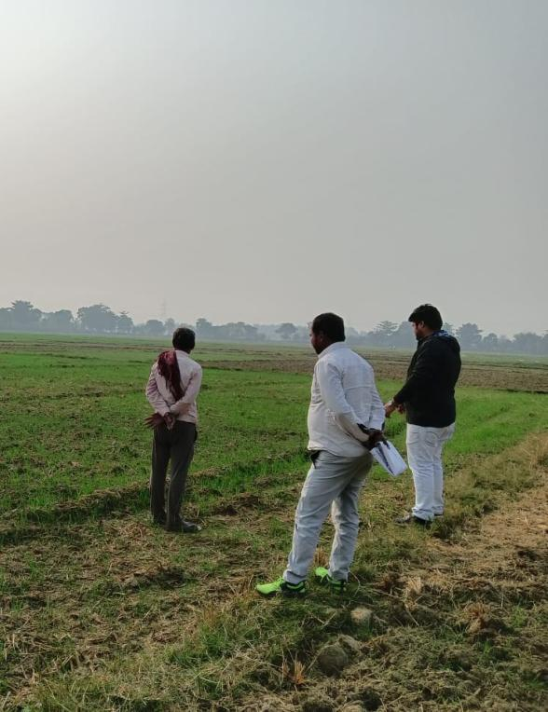

Thanks

